Slide 1
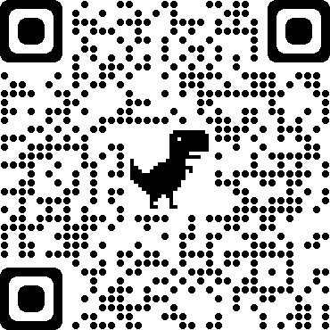

IBM HR ANALYSIS
TEAM BARBARIANS
BU.330.780.T1.SP21
Data Science and Business Intelligence
Minghao Du, Mengying Zhao, Wenlu Chen, Haitong Ni, Haoyu Wang

Slide 2
Business Understanding
High attrition —— High Risks & High Cost​
Target Variable: Attrition​
Find out the factors that are highly relevant to employee attrition​
Notes:
High attrition can cause many huge, serious problems within an organization. The company must bear a lot of risks, for example, the sudden departure of employees will result in the interrupted of executing tasks. All of these will have a negative impact on the company's future development. ​
​
In this case, our target variable is attrition. Employee resignation is composed of many factors. In order to reduce the number of Employee resignation, we need to find out the factors that are highly relevant to employee attrition. This can help the company better planning and developing solutions to reduce the possibility of employee attrition. ​

Slide 3
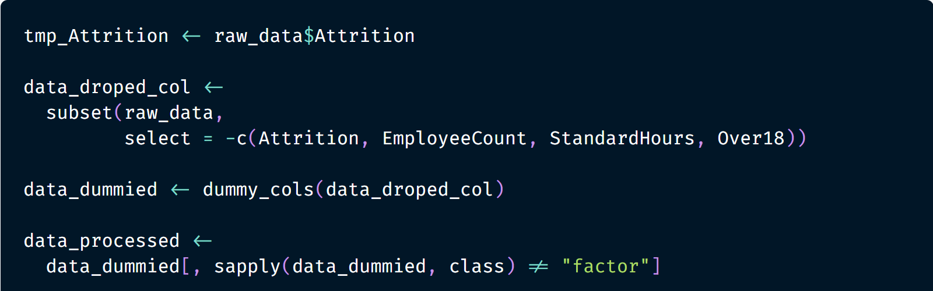
Data Understanding & Preparation​
Retrieved from Kaggle.com​
Notes:
The data used to address our business problem was retrieved from Kaggle: IBM HR Analytics Employee Attrition & Performance. ​
By looking at the problem we need to solve and observing the data set features, this is a classification problem. The training data set includes 35 variables (columns) and 1470 rows. The variables “Attrition” is our target variable, it means that whether the employee resigned or not. ​
By observing the characteristics of the data, some variables cannot be quantitatively processed. To better analyze the data, we created some dummy variables. Split the variables of a certain category, for instance, setting "Gender" to two dummy variables "Gender_Male" and "Gender_Female". Here is our data preparation part. ​

Slide 4
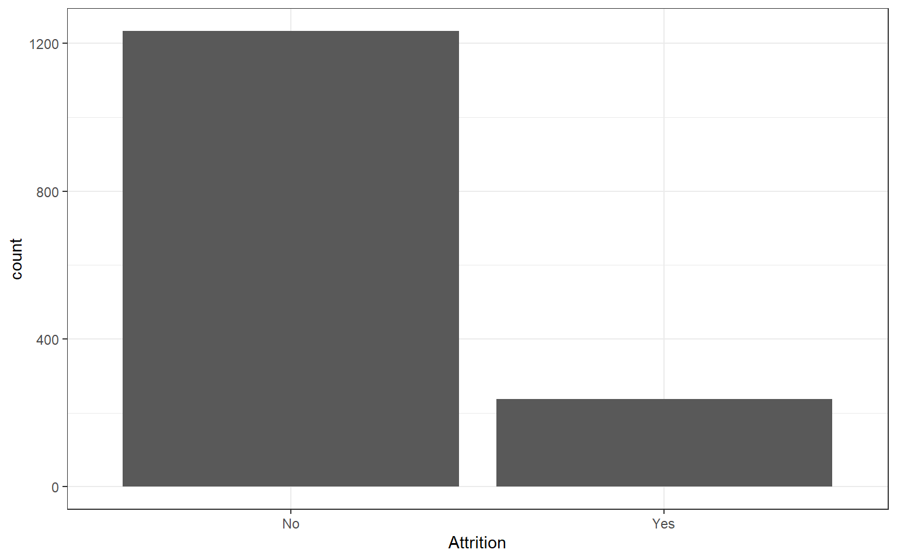
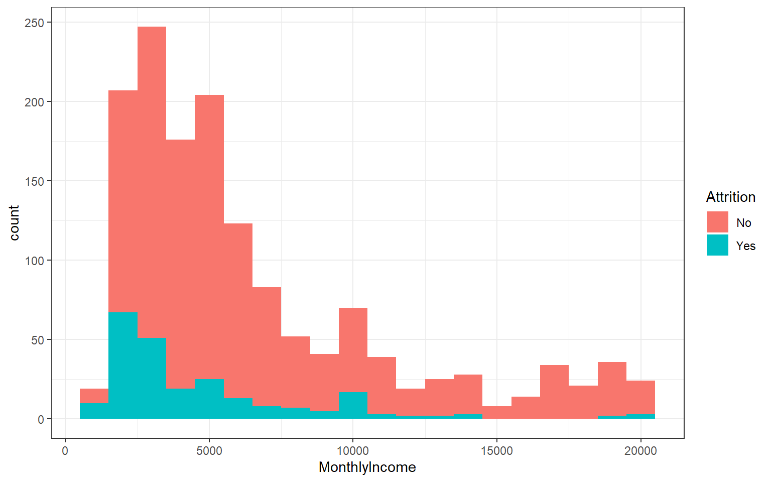
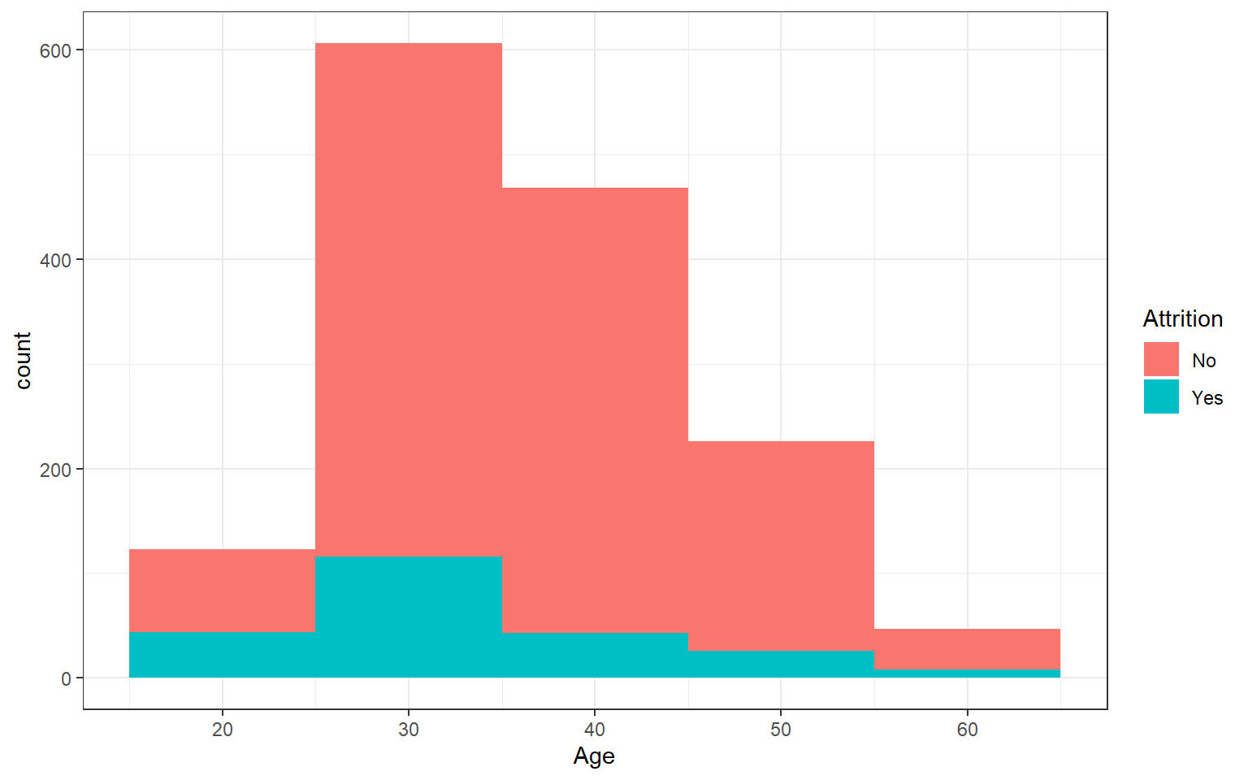
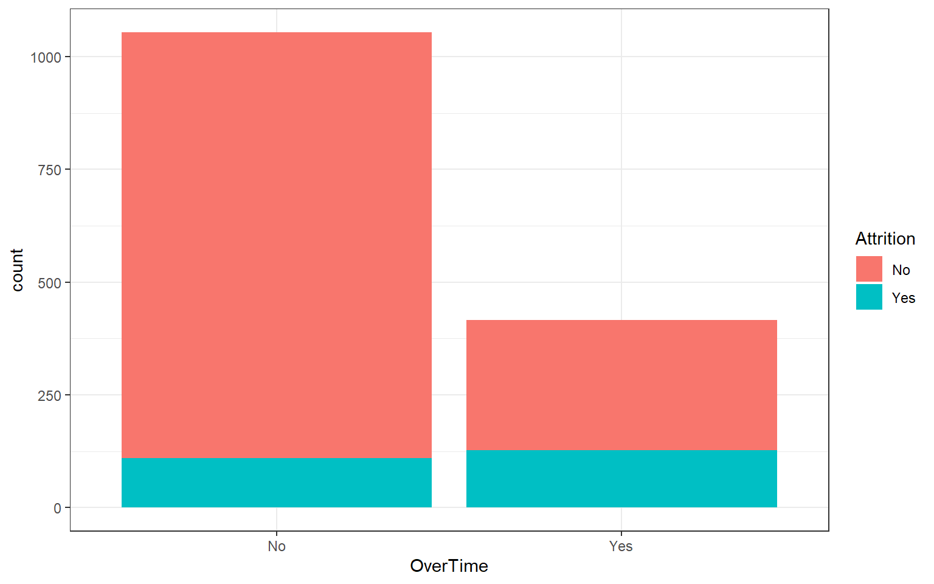
Attrition
Attrition & Age
​Visualization
Attrition &Monthly Income
Attrition & Over Time
Notes:
To better understand the data set, we plot several histograms for the raw data. as you can see from the exhibit thre, Our target variable contains more than 12,00 “No” and around 220 “Yes”, which means around 15% of our data set was Attrition​
​
In Exhibit 4, the histogram between Attrition and Age demonstrates that the most part of employees are in their 25-35​
​
In Exhibit 5, we plot the histogram for Monthly Income and the number of Attrition. The $1000-$2000 level contains the highest number of Attrition, but almost no Attrition since the Monthly Income reached $15,000.​
​
In Exhibit 6 the bar chart between Over Time and Attrition displays higher Overtime in “Yes” column than “No”, which indicates that the extra working time might increase the Attrition. ​
​

Slide 5
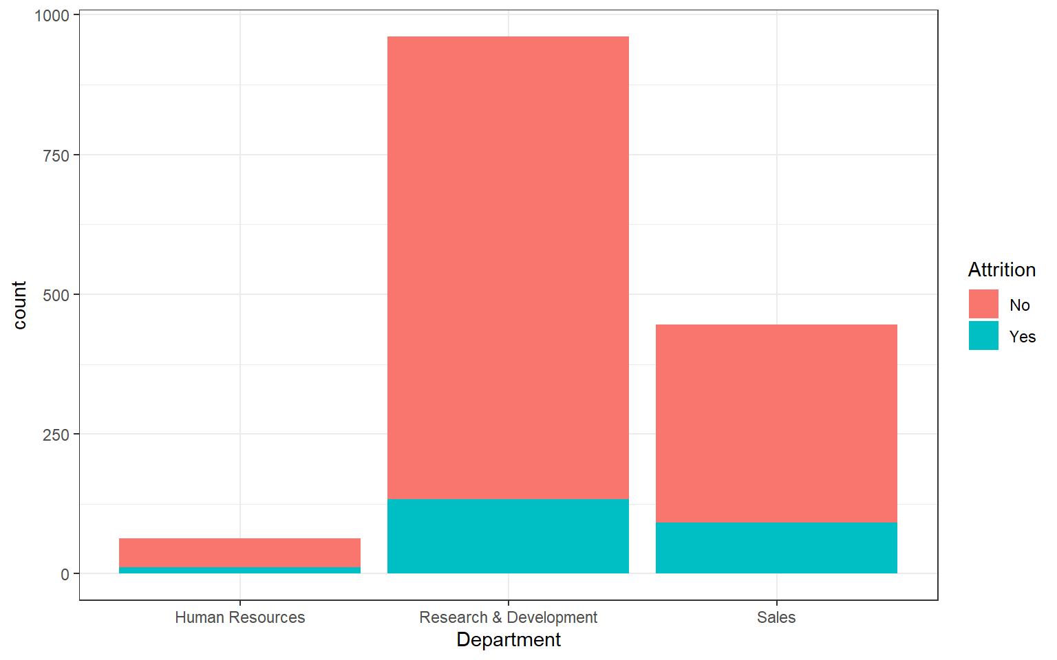
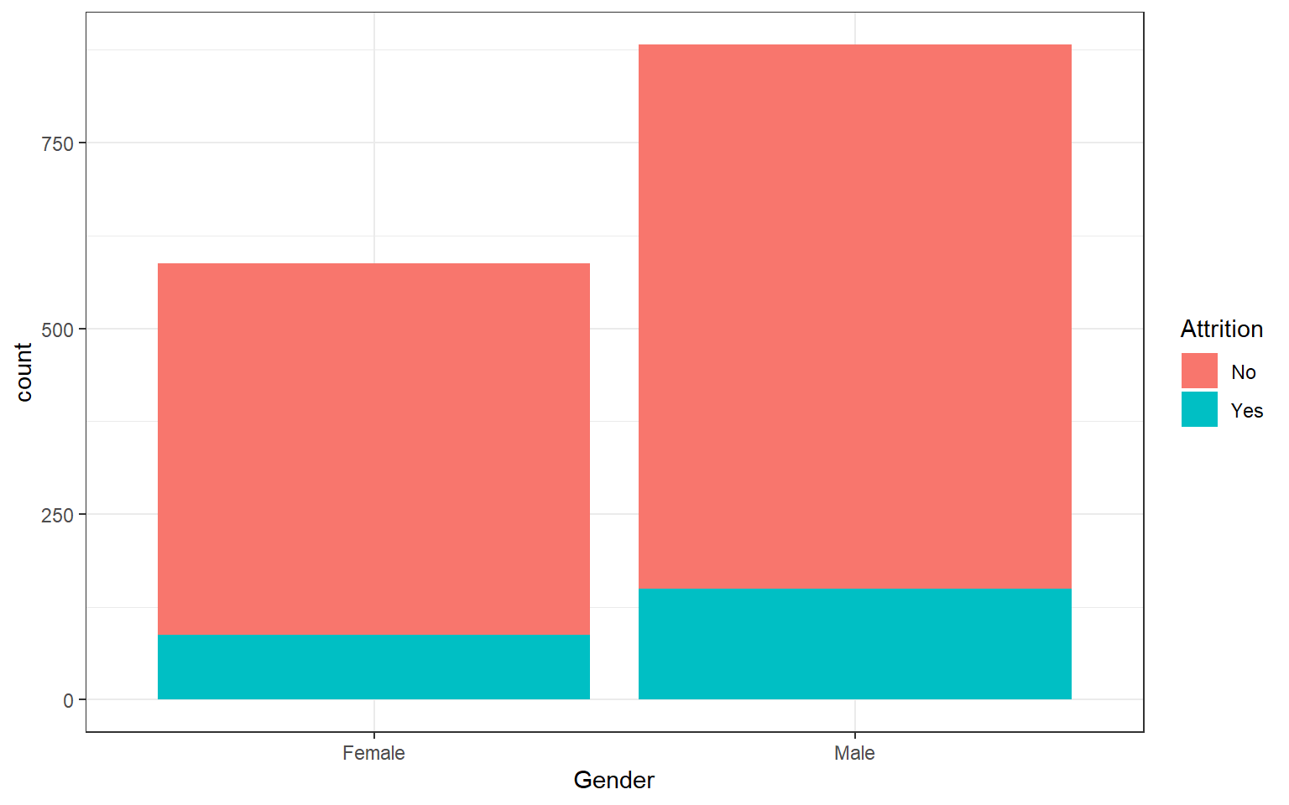
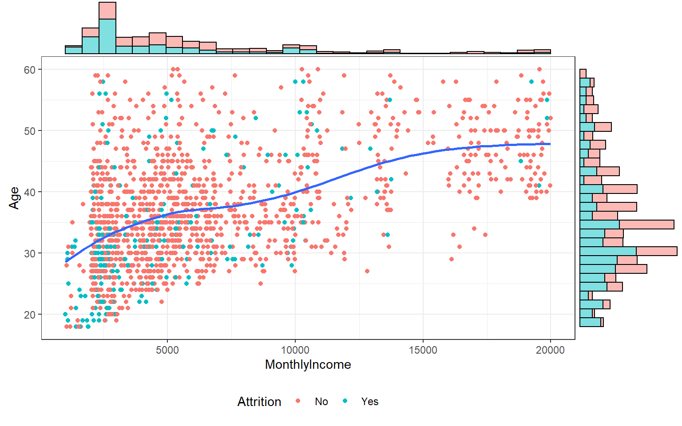
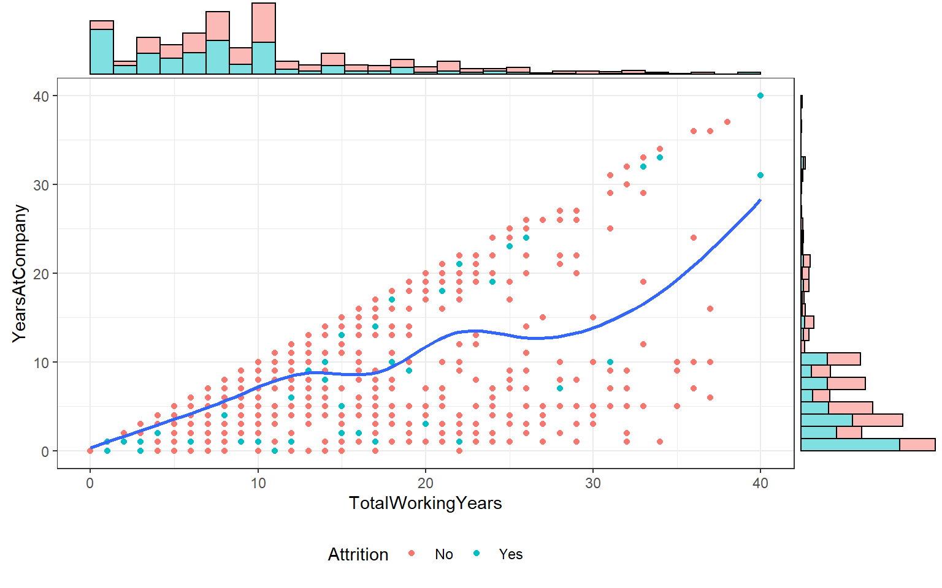
Attrition & Department
Attrition & Gender
​Visualization
Monthly Income & Age
Work Years & At Company
Notes:
In Exhibit 7, the bar chart displays that the Research & Development has the greatest number of employees; Also, Research & Development contains the greatest number of Attrition.​
​
In Exhibit 8, the number of male employees is larger than female employees, while the number of Attrition for male employees is more than female’s Attrition.​
​
In Exhibit 9, the scatterplot between the Monthly Income and Age illustrates that employee who has lower monthly income and younger age are more likely to be Attrition. On the other hand, we do have more dense data in the lower monthly income and younger age, and sparse data distribution in higher monthly income and older age, which might bring influence on the prediction. ​
​
In Exhibit 10, the scatterplot between the Total Working Years and Years at Company reveals that employee who has less Total Working Years and less Years at Company are more likely to be Attrition. However, we do have more dense data in less Total Working Years and less Years at Company, which might also impact the prediction.​
​
​

Slide 6
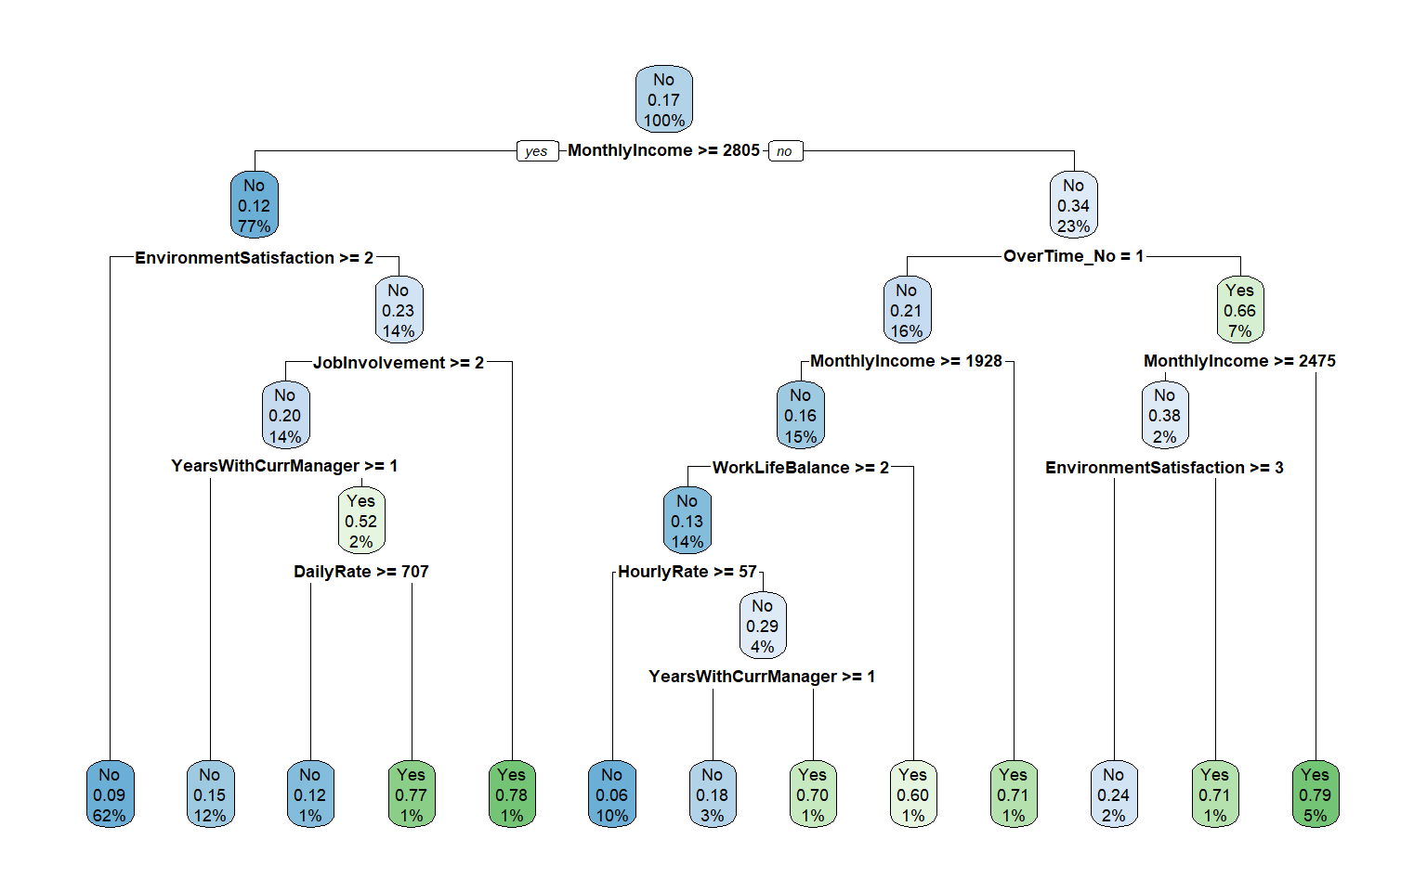
Model 1: Decision Tree
Important Factors:​
​
1. Monthly Income​
2. Over Time​
3. Environment Satisfaction​
4. Daily Rate​
5. Job Involvement​
6. Work Life Balance​
​
Accuracy Rate for the model:​
0.8125​
Notes:
The main goal of our project is to predict which types of employees are more likely to decide attrition and which factors will most affect employees' decision to leave. We decided to build the first model-decision tree to explore the interaction between factors. First, we randomly use half of the data as the training dataset and the other half as the testing dataset. According to the performance of the decision tree we built on the training dataset, we can conclude that monthly income, years with current manager, work life balance, job satisfaction, over time, stock option level environment satisfaction and job role have a greater impact on employee attrition. Specifically, employees with monthly income less than 2805, over time, environment satisfaction less than 3 and work life balance larger than 2 are more likely to make attrition decisions. The accuracy rate for the first decision tree model is 0.8125. ​

Slide 7
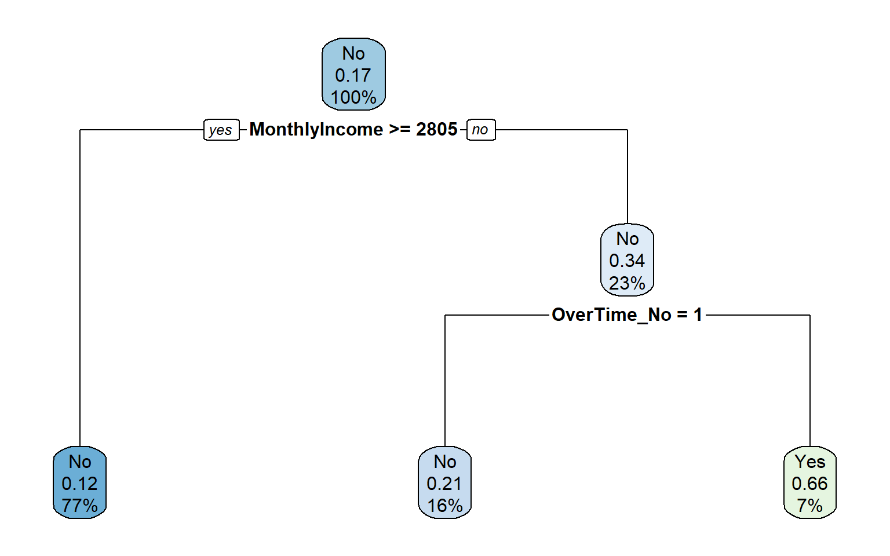
Decision Tree – Continued​
Important Factors:​
​
1. Monthly Income​
2. Over Time​
​
​
Accuracy Rate for the model:​
0.8478​
​
Notes:
After that, we try to limit the characteristics of the decision tree and change some criteria to find the best decision tree to predict our target variable. In this decision tree, we found that monthly income and over time can best represent to predict attrition or not. In detail, employees with monthly income less than 2805 and over time are more likely to choose attrition. Based on the result, we know that our best decision tree model’s accuracy rate is 0.8478, which is higher than our first model.​

Slide 8
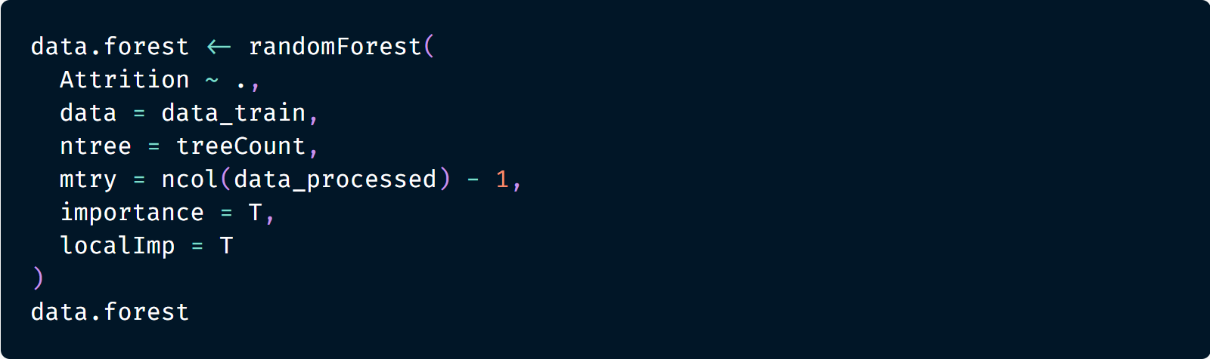
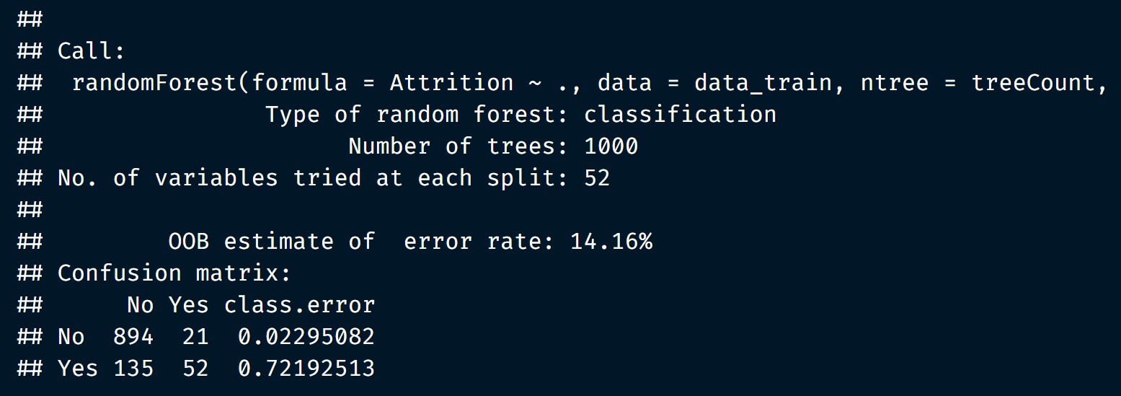
Model 2: Random Forest ​
Notes:
In this dataset, the target is to predict the attrition result of employees under different situations, including hour rate, environment, age, job satisfaction and so many other factors. Random Forest model is effective and flexible by allowing each individual tree to randomly sample from the dataset with replacement, resulting in different trees. ​
​
Each individual tree in the random forest spits out a class prediction and the class with the most votes become our model’s prediction. In this investigation, we have 1470 uncorrelated samples, and we created a validation set by using 75% of samples as our training data and the rest of it as our testing data, which is for the model not overfitting. Firstly, we tested the hyper parameter “mtry” as the (Exhibit 13) shows.​
​
When training data is ready, the (out-of-bag) data is for estimating the classification error as trees, which is also used to get estimates of variable importance. The OOB estimate of error rate is 14.16%, and the result is unbiased.​

Slide 9
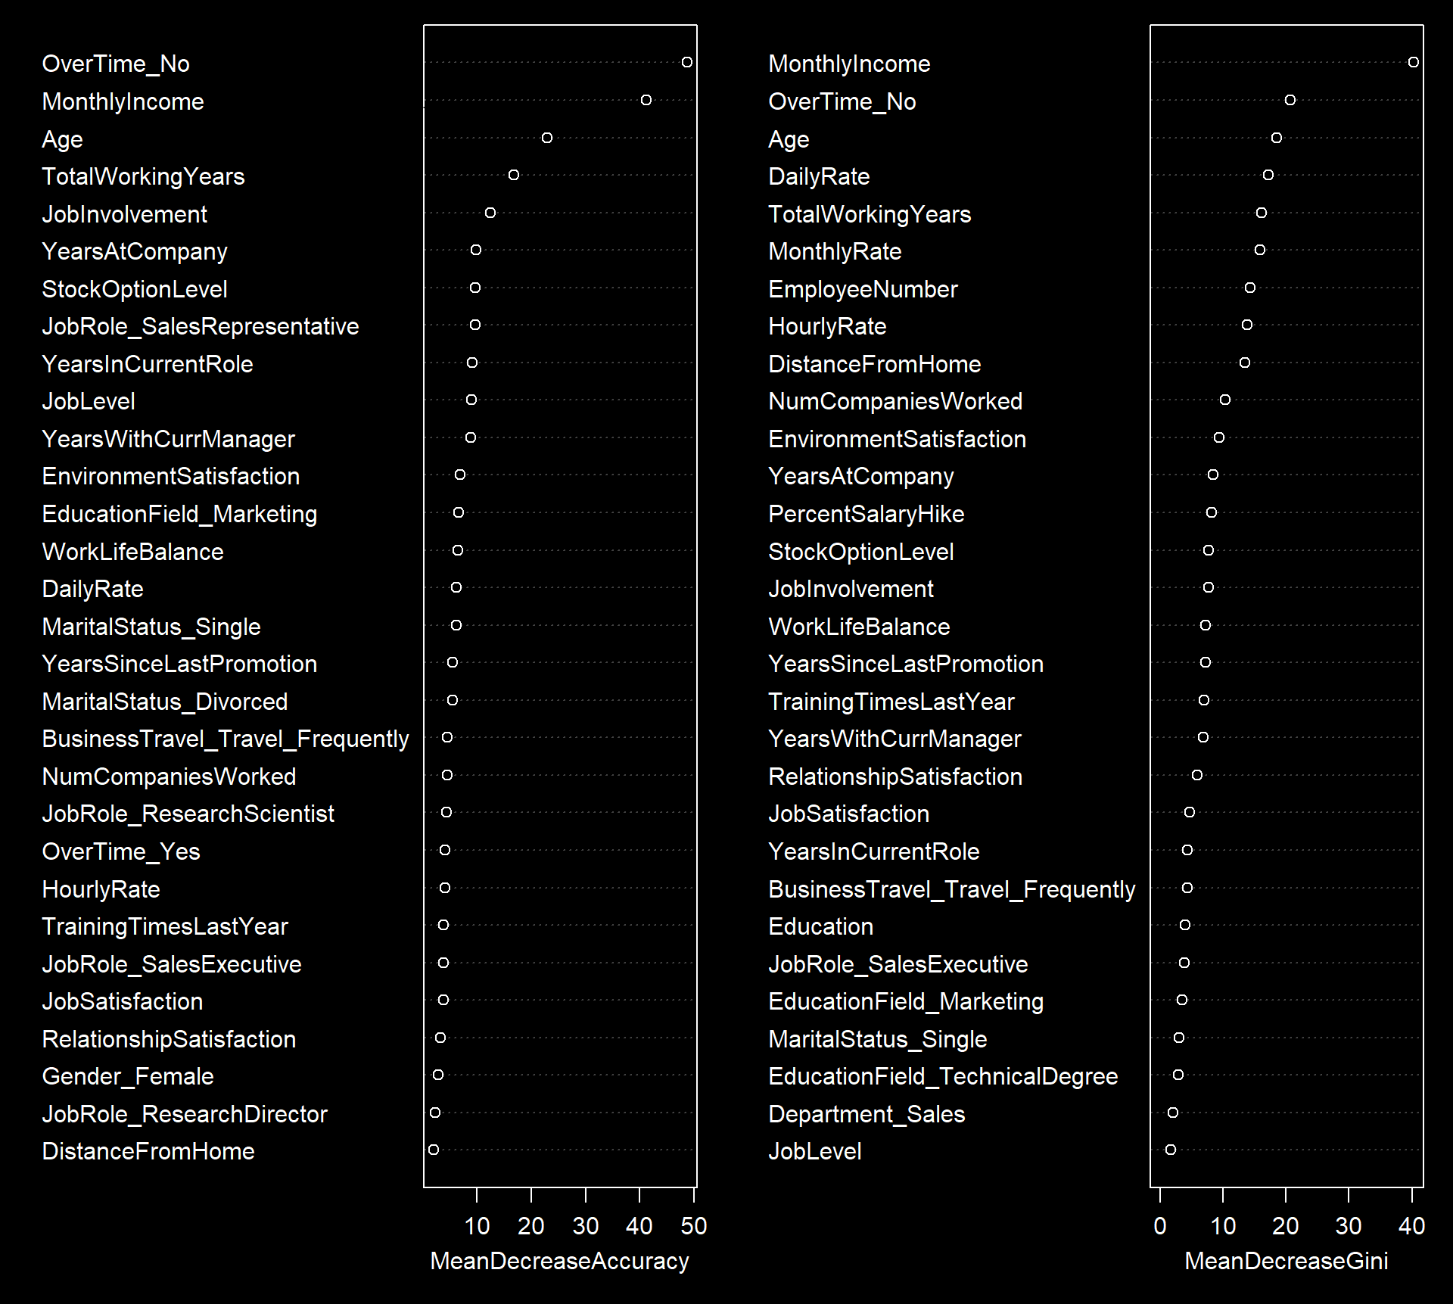
Random Forest – Continued​
Feature Importance:​
OverTime_No
MonthlyIncome
Age
JobRole
Marital_Status
YearsSinceLastPromotion
TotalWorkingaYears
JobRole
StockOptionLevel
JobSatisfaction
RelationshipSatisfaction
Notes:
The feature importance's in a random forest can help us figure out what predictor variables the random forest considers most important. According to our test, there are 11 relevant variables that are critical to our target.​
​
Then, we used Brute-force search for best mtry, and we have obtained that mtry equals to 2 through this method. In general, Brute-force search is useful as a baseline method when benchmarking other algorithms or metaheuristics. Since our dataset has limited samples, we can use this method efficiently to get results​

Slide 10
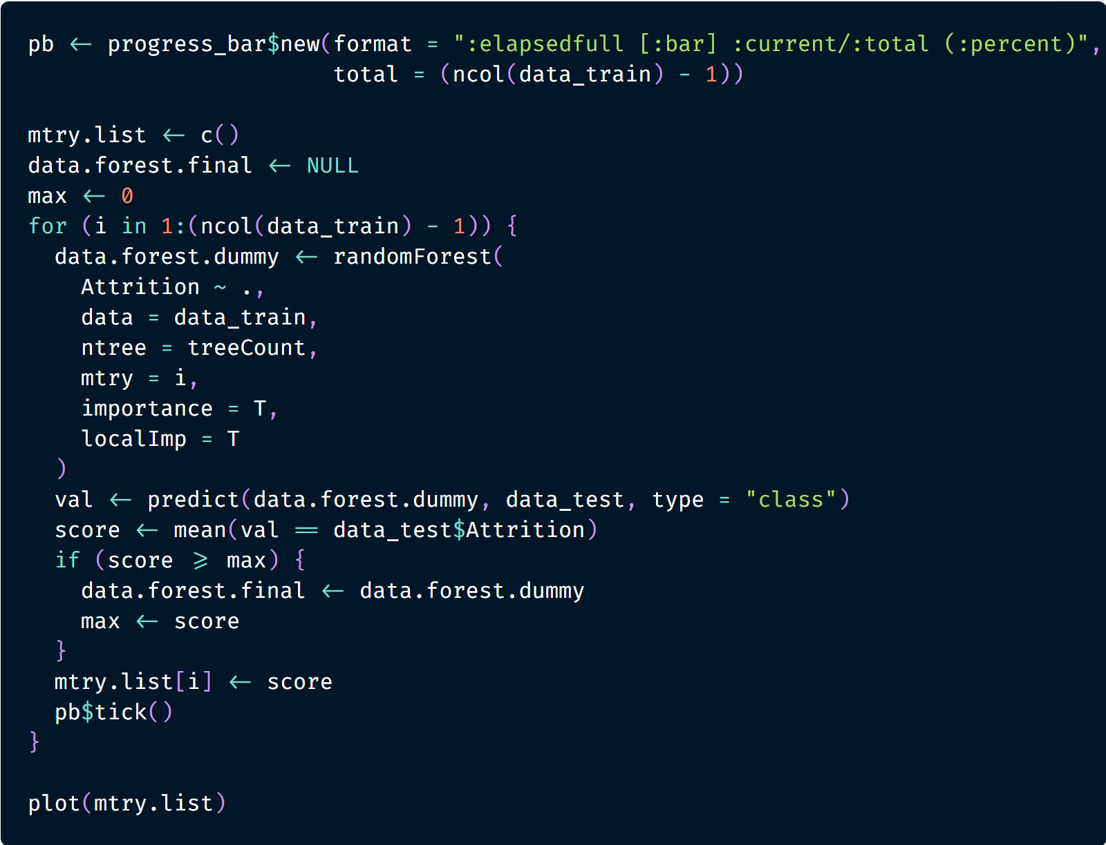
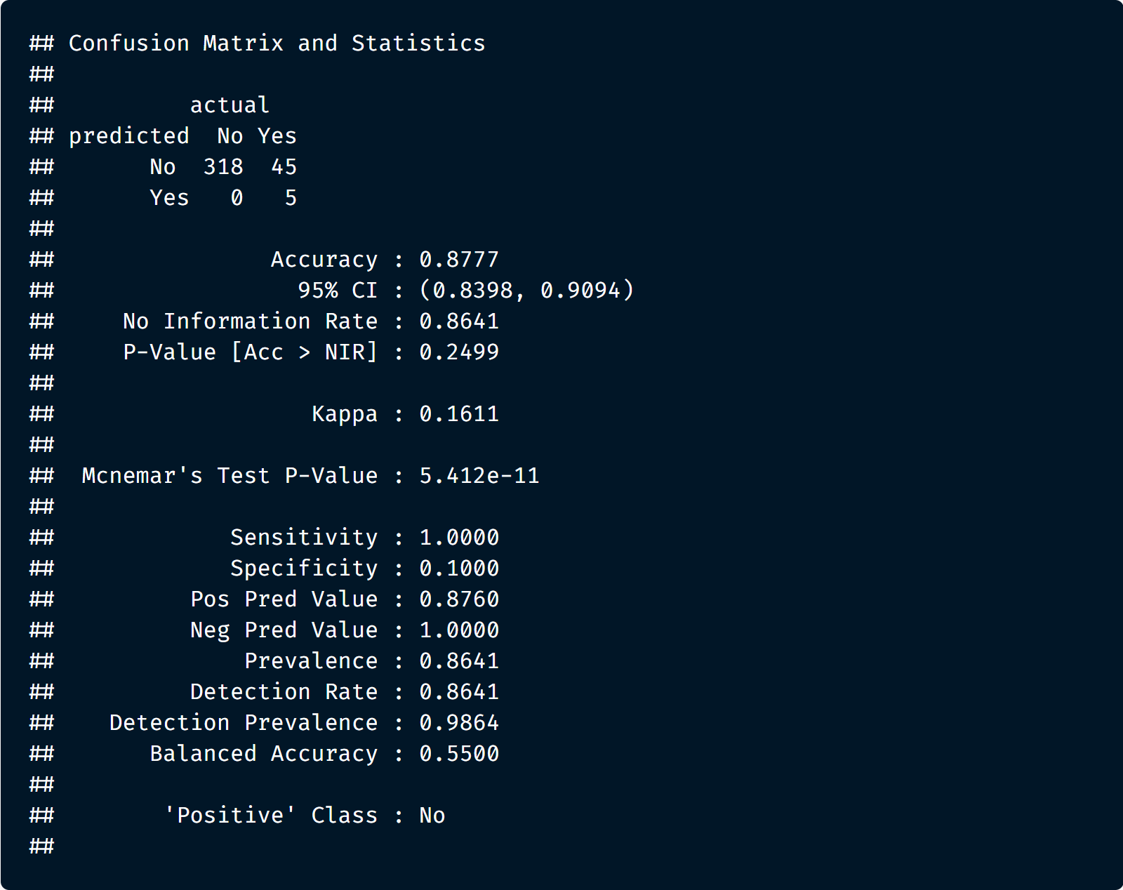
Random Forest – Continued
Notes:
​
According to our model, another diagnostic measure of the model we can take is to plot the confusion matrix for the testing predictions. We can see in the model that, based on predictions, how many got correct in the top left and bottom right corners and how many were missed in the lower left and upper right. In summary, the accuracy rate of our random forest model is 0.8777, which outperforms the single decision tree (Exhibit 16).​

Slide 11
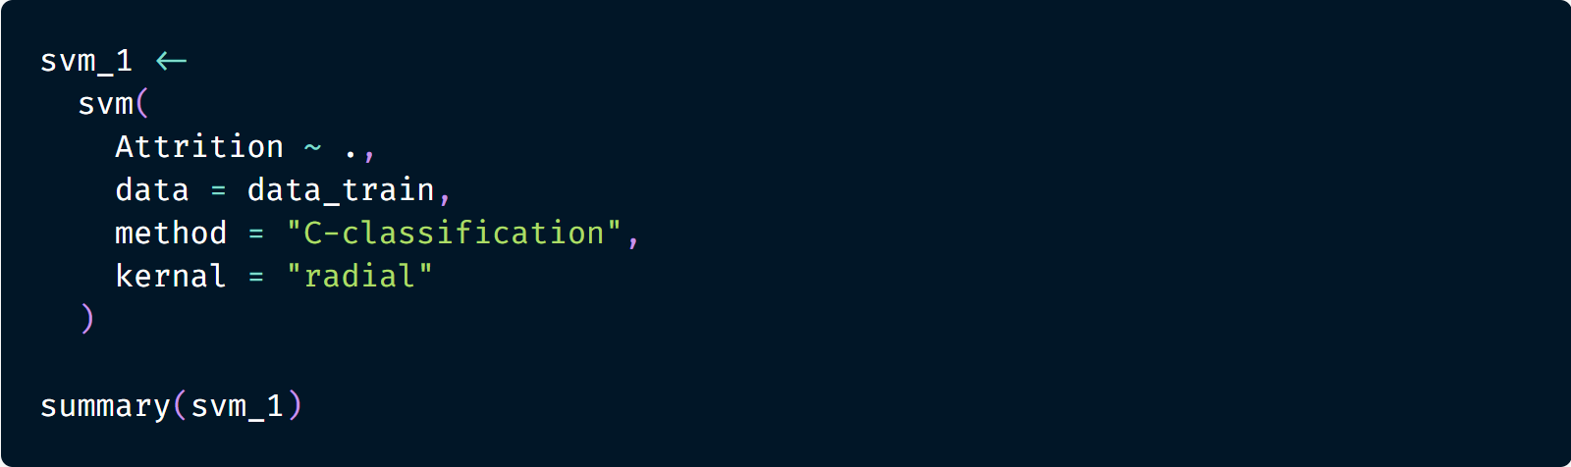
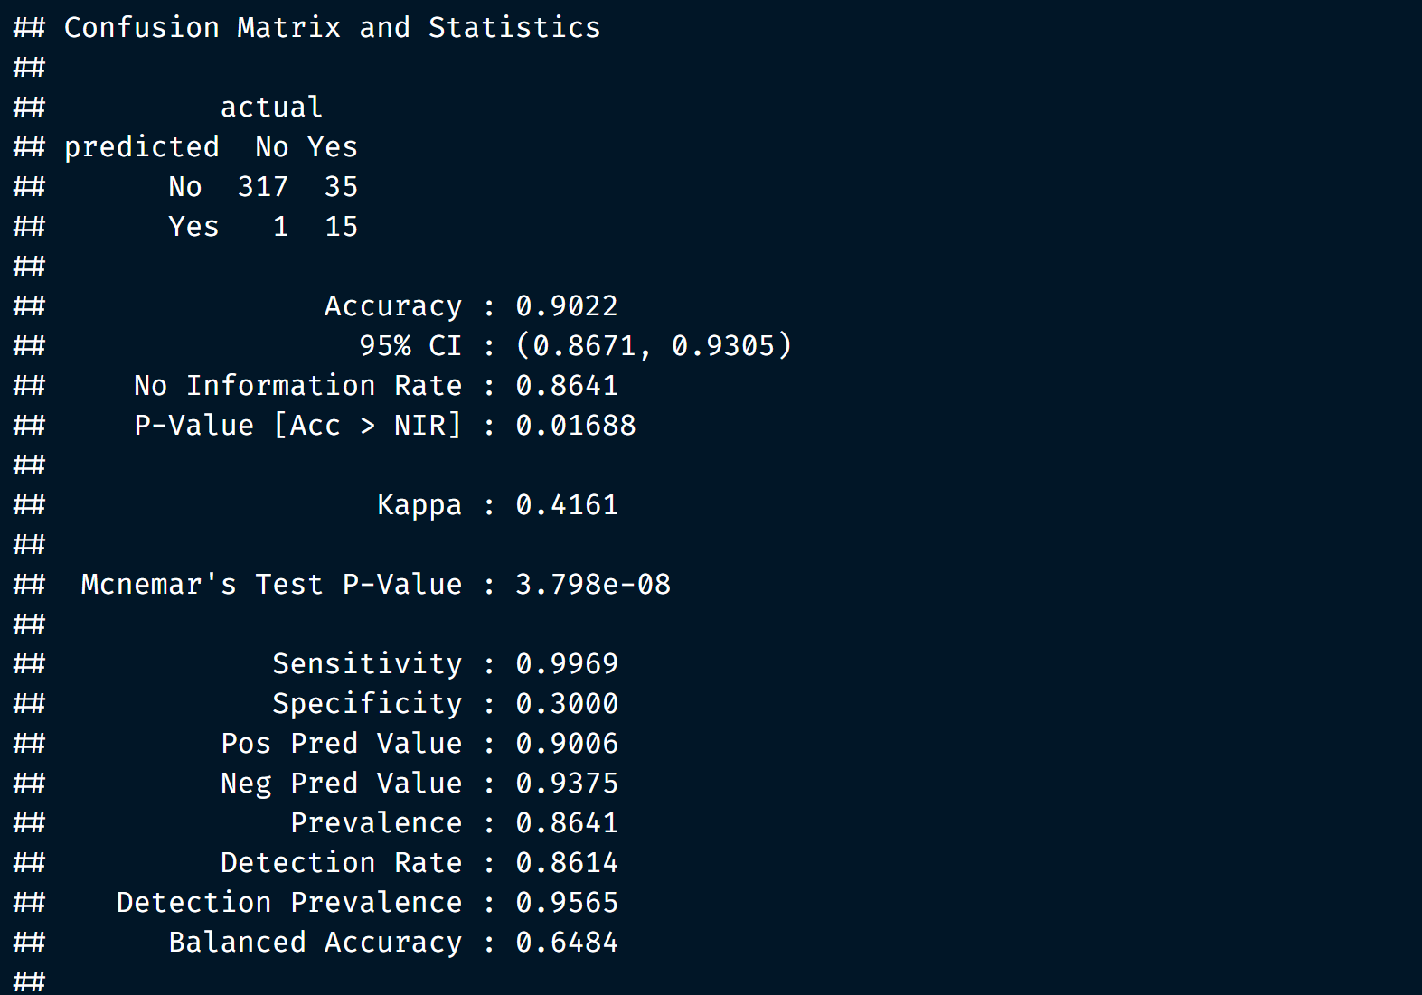
Model 3: SVM
Notes:
The Support Vector Machine (SVM) model is a supervised machine learning model that can classify two (or more) factors target variable depending on the choice of kernels. In our case, the processed data presents 52 independent variables and one target variable (Attrition); thus, while fitting to the training data, the SVM model will generate the best hyperplane in a 53-dimensional space.
For the first attempt we passed all training data to a SVM model with a radial kernel. We then apply the model to the preserved testing data to generate a set of predicted Attrition values. This predicted attrition value is used to compare with the actual attrition value in the testing data to calculate the accuracy value.
As you can see on the right-hand side, this baseline model has an accuracy of 90.22 percent.

Slide 12
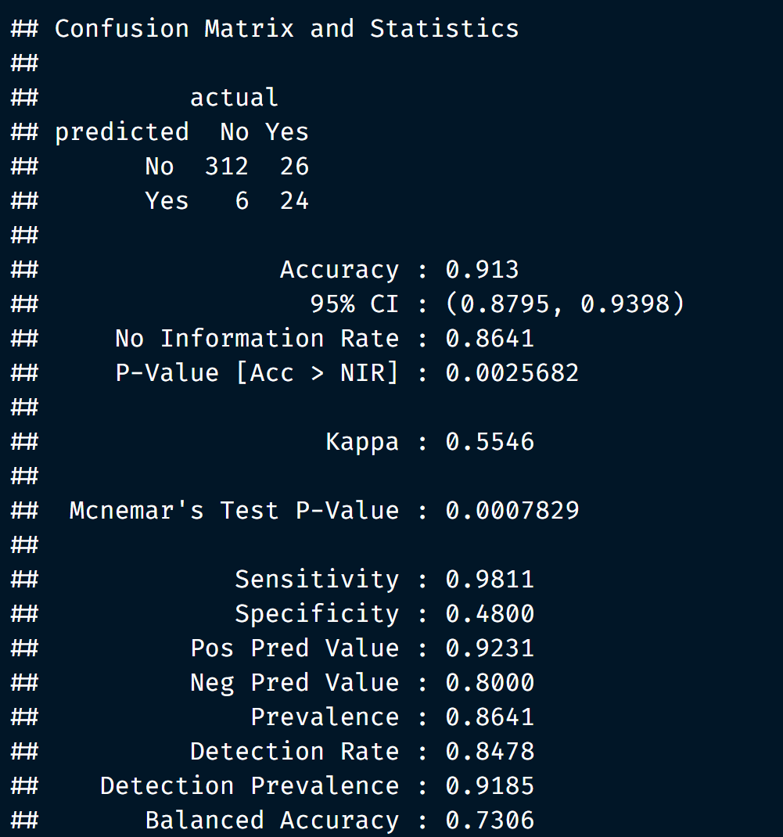
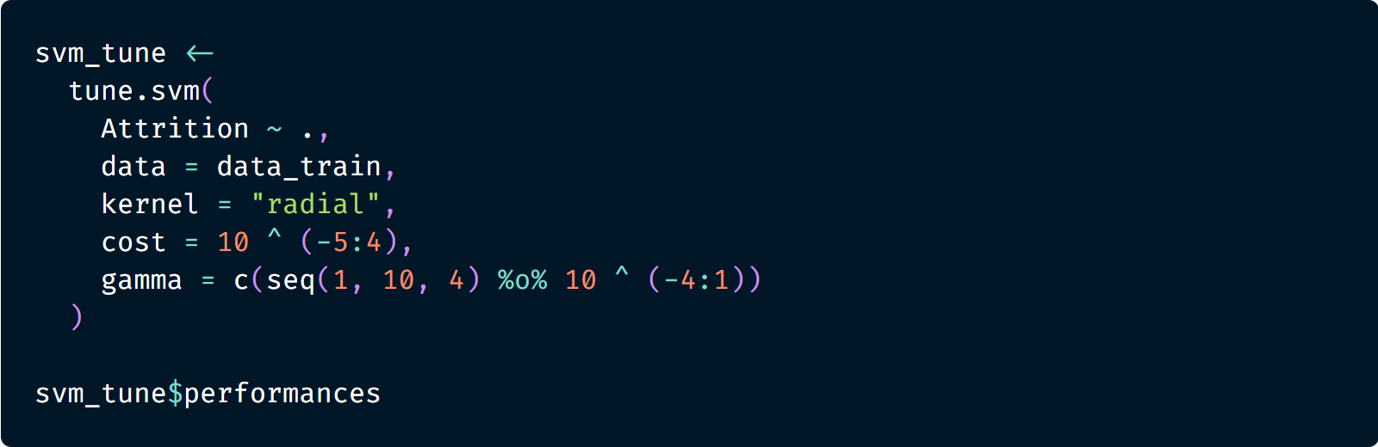
SVM - Continued​
Notes:
Given the radial kernel is sensitive to cost and gamma (hyperparameter), the model might benefit from fine tuning with high resolution hyperparameters. Hence, for cost, we prepared a sequence ranging from 1e-5 to 1e4 with 10x increment, and for gamma, we prepared a sequence ranging from 1e-4 to 10 with 5x increment. Applying the combination of these two hyperparameters, the best SVM model shall select from 180 candidate models. As a result, the outputted best SVM model is tuned with cost of 100 and gamma of 5e-4.
Applying the tuned model to the preserved testing data set, a set of predicted attrition value is generated. These predicted values are then checked against the original ones to calculate the accuracy of the model.
As the result shown, after tuning the model a slight increase of accuracy is emerged. On the other hand, while comparing the balanced accuracy of both models, the improvement is significant from 64.84% to 73.06%. As the matter of utilizing the model to predict attrition, both are equally good.

Slide 13
Evaluation​
 | Decision Tree | Random Forest | SVM
True Positive | 8 | 5 | 23
True Negative | 304 | 318 | 312
False Positive | 14 | 0 | 6
False Negative | 42 | 45 | 27
Accuracy | 0.8478 | 0.8777 | 0.9130
Sensitivity | 0.9560 | 1.0000 | 0.9811
Specificity | 0.1600 | 0.1000 | 0.4800
Balanced Accuracy | 0.5580 | 0.5500 | 0.7306
Notes:
At this point, all three models had built, tuned, and tested against the preserved testing data set.
As shown above, we can say that the SVM model has the highest accuracy rate, which arrives at 91%. The random forest model has the second highest accuracy rate, and the decision tree model has the lowest accuracy rate. The same situation applies to the balanced accuracy of these models, having SVM with the highest balanced accuracy of 73.06%.

Slide 14
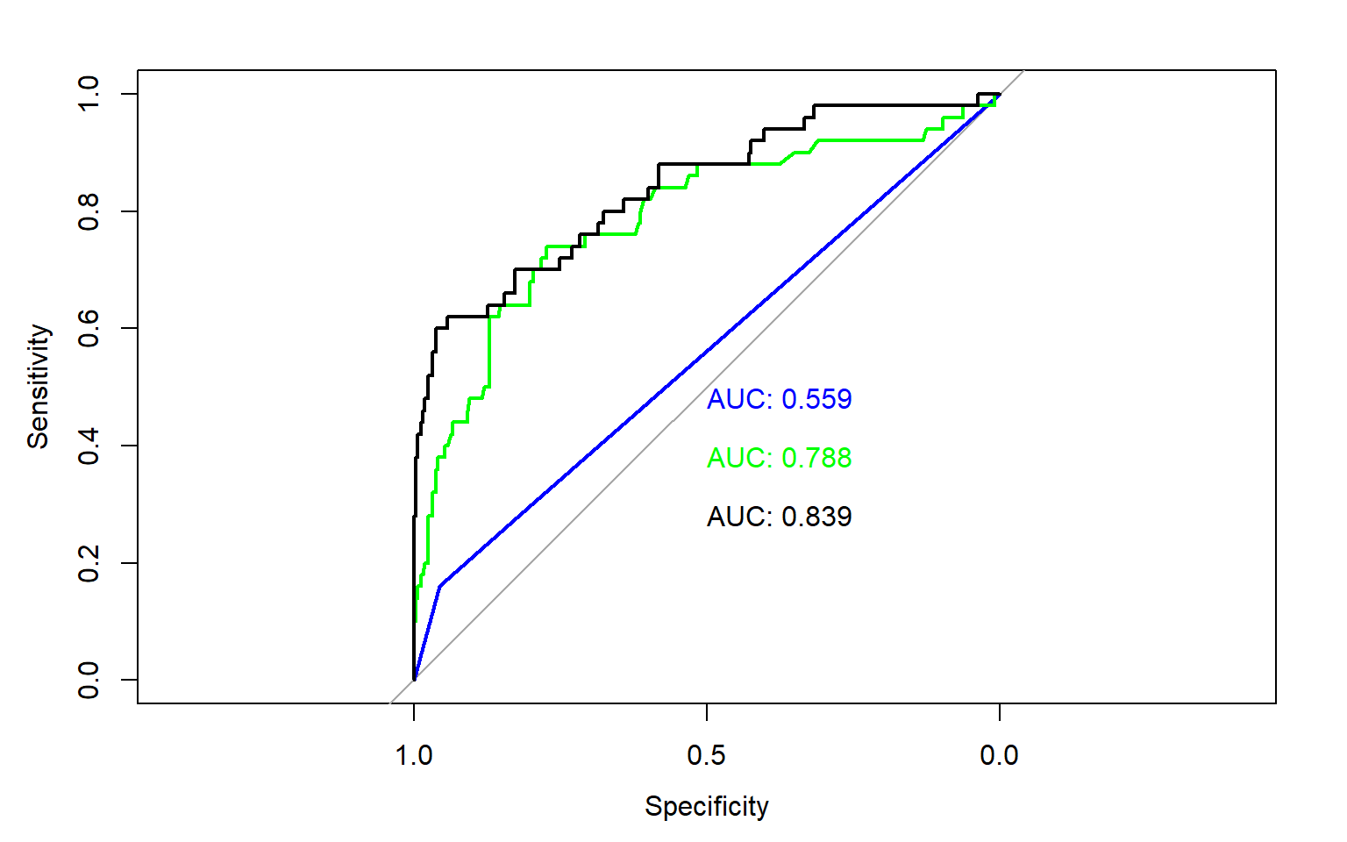
Evaluation​ - Continued​
SVM
RF
DT
Notes:
AUC is also an important fact to show how our model performs in the testing dataset. Based on the ROC plot below, it shows AUC values among three different models. Black line represents SVM model performance and green line represents random forest model and blue line represents decision tree model performance. We can clearly say that the random forest and SVM model’s performance are much better than the decision tree model. Compared with the random forest model, although at some point, the random forest model has higher sensitivity, overall, the SVM model has higher AUC value (0.839). Therefore, our group thinks the SVM model is the best model we created.
From a practical standpoint, both SVM and random forest are equally good in terms of predicting employee attrition. However, when it comes to formulating plans to decrease attrition rate, random forest provides more relevant information like variable importance and prediction visualizations. Hence, depending on the application, both model offers different perks for different aspect of the problem that the firm is facing.

Slide 15
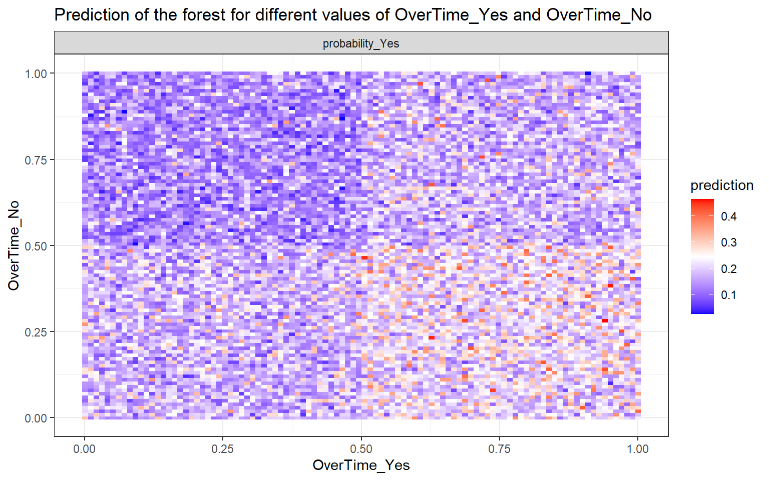
Deployment​
Important Variables:
Overtime
Monthly Income
Age
Total working years
Found:
The higher the overtime, the greater the possibility of employees leaving.
Notes:
According to the above evaluation, Random Forest and SVM perform better in these three models, so the next we will conduct further analysis based on Random Forest. ​
Based on the results of the random forest above, there are 11 variables in total that are significant relative to the attrition. We choose the first four variables. They are “Overtime”, “Monthly income”, “Age” and “Total working years”. ​
​
By observing the chart, it can be found that the higher the overtime, the greater the possibility of employees leaving. ​

Slide 16
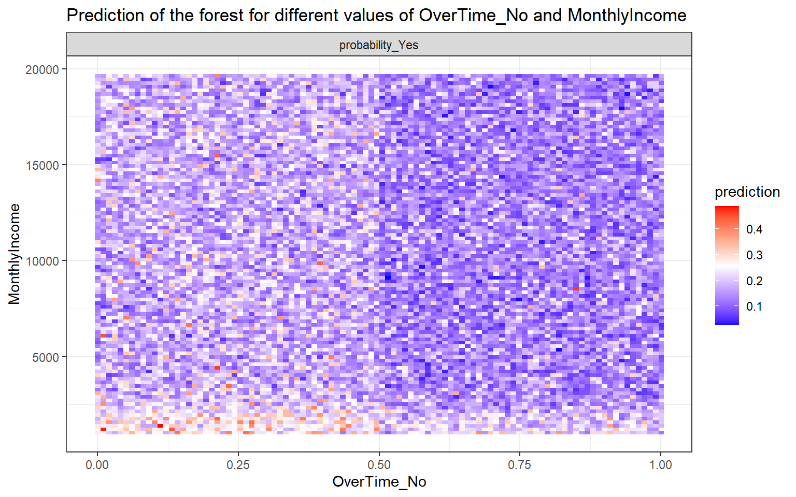
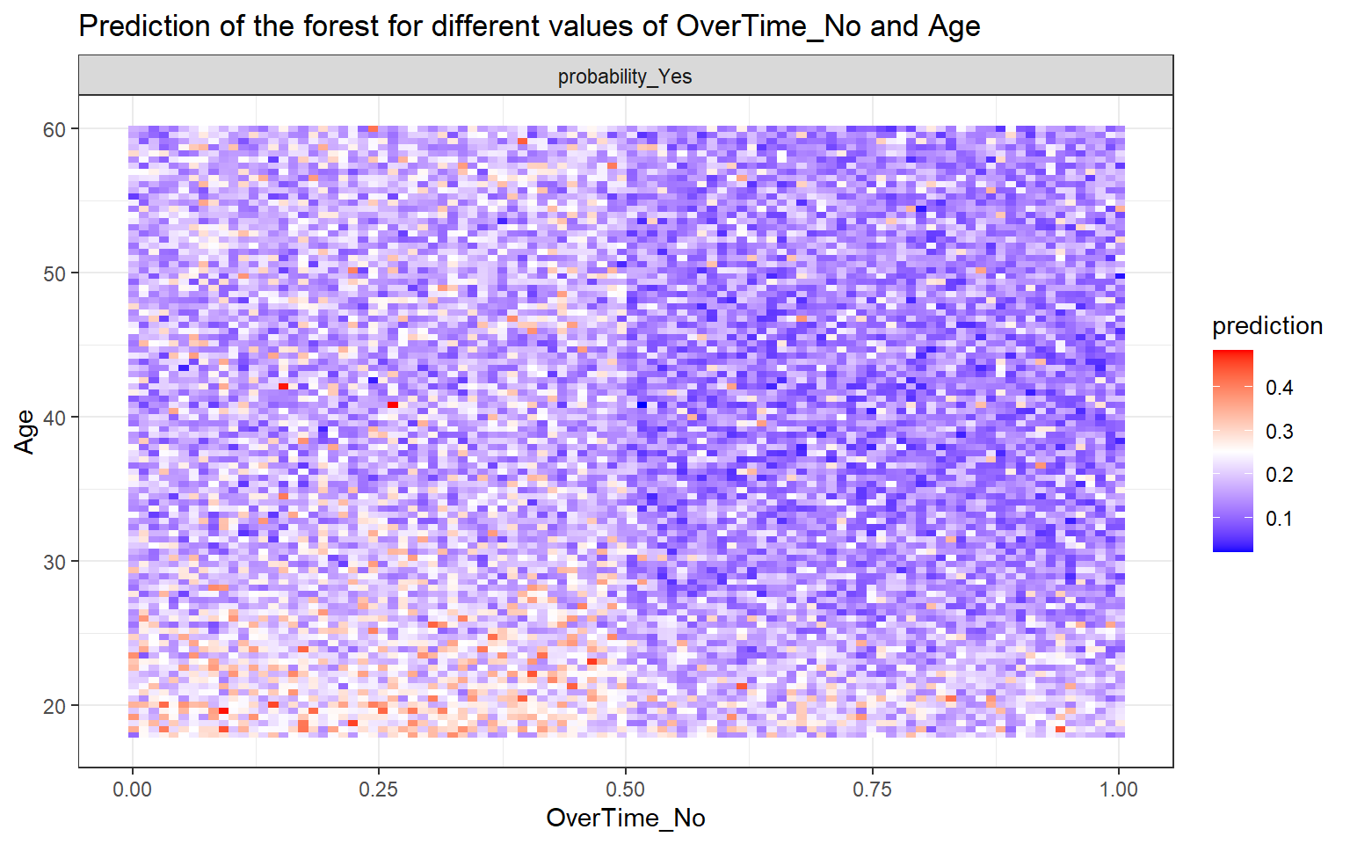
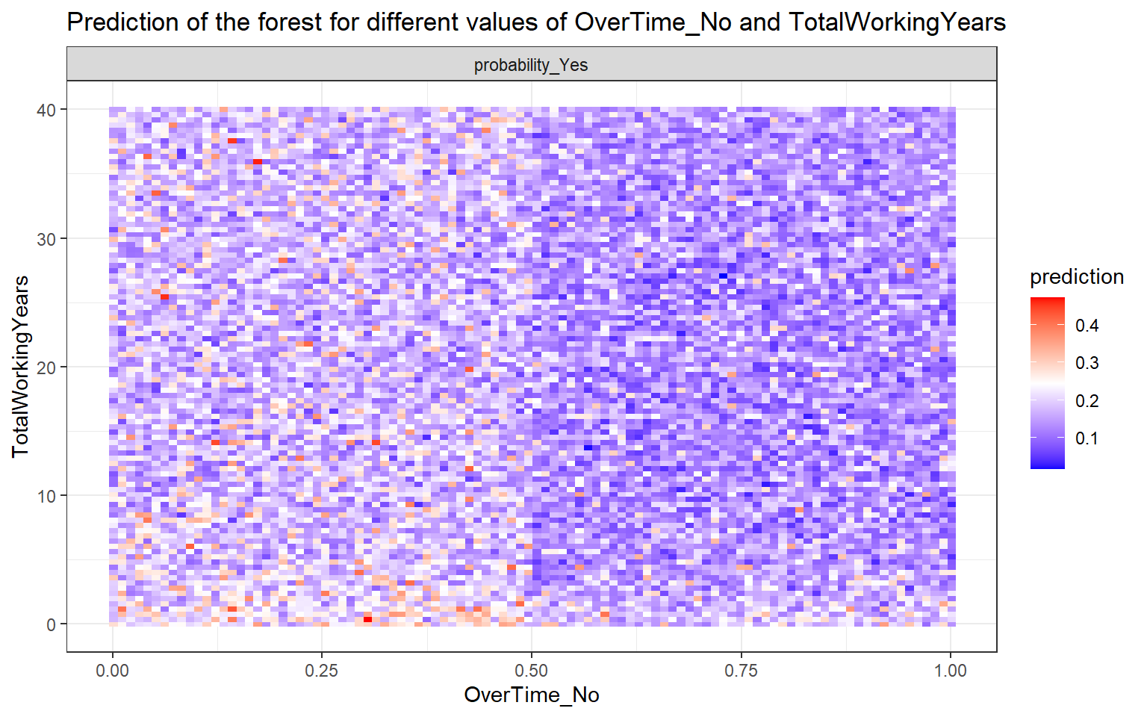
Deployment​ - Continued​
Monthly Income < $2500
Age < 22
Total working years < 2
Important Variables:
Overtime
Monthly Income
Age
Total working years
Conduct further investigations internally to summarize how employees can reduce negative emotions under the overtime circumstances.
Adding additional work allowances or benefits to overtime employees and so on.
Notes:
And through analysis, under the premise of high overtime rate, employees whose monthly salary is less than approximately 2500 dollars, the age is less than 30, and the total working year is less than 5 years are more likely to leave. Therefore, in view of this feature, the company can conduct further investigations internally to summarize how employees can reduce negative emotions under the overtime circumstances. Or adding additional work allowances or benefits to overtime employees and so on. ​
​

Slide 17
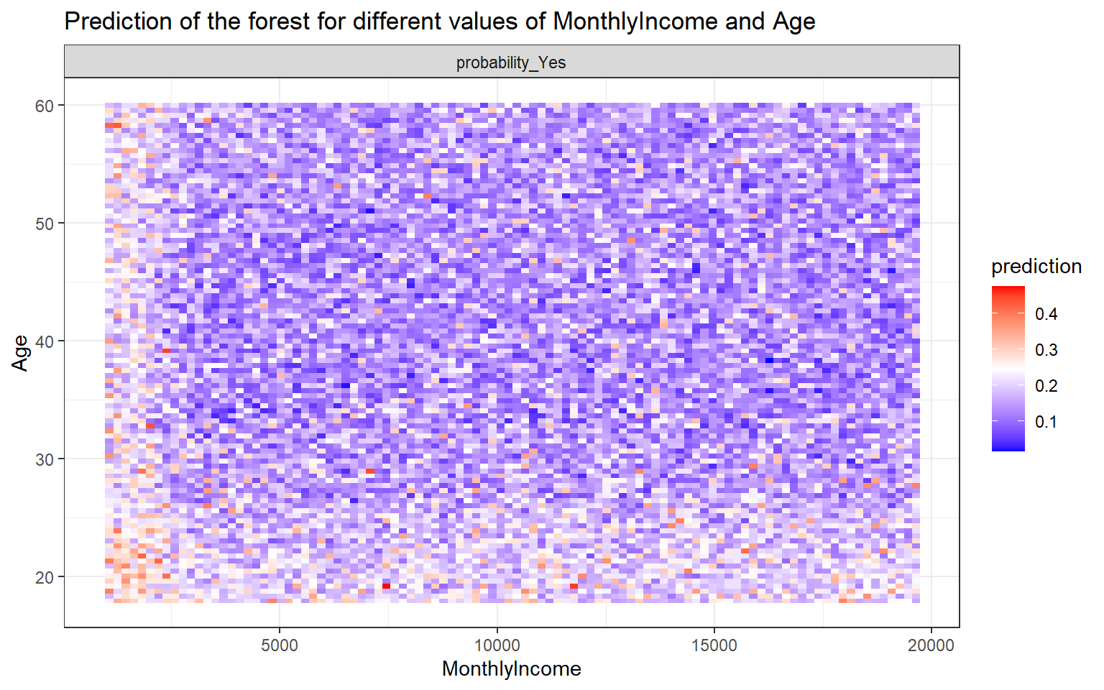
Deployment​ - Continued​
Important Variables:
Overtime
Monthly Income
Age
Total working years
Reconsider the salary setting
Raising the minimum salary, which needs to be in line with the current talent market conditions.
Found: When the monthly income is lower than 2500 dollars, young people who aged lower than 27 are relatively more likely to resign.
Age-Monthly Income
Notes:
Through continued analysis, it can be found that when the monthly income is lower than 2500 dollars, young people who aged lower than 27 are more likely to resign. According to this, the company may have to reconsider the issue of salary setting, such as raising the minimum salary, which needs to be in line with the current talent market conditions. ​

Slide 18
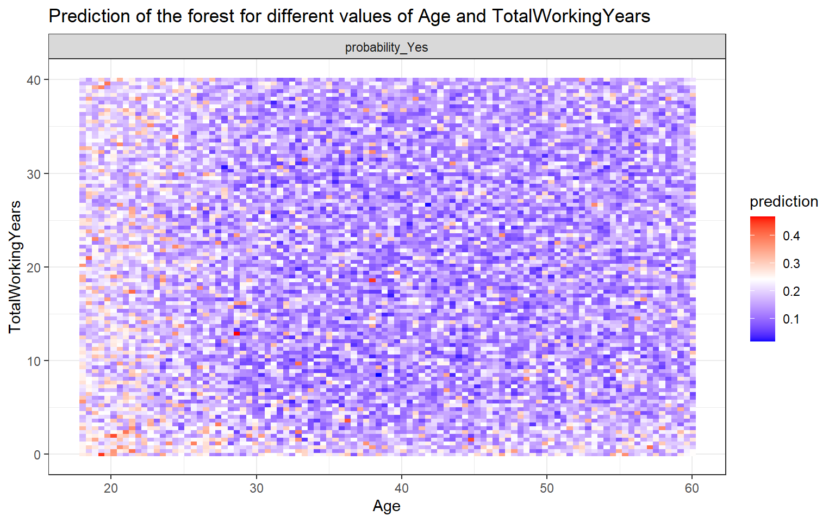
Deployment​ - Continued​
Important Variables:
Overtime
Monthly Income
Age
Total working years
To ensure that employees form appropriate expectations.
Companies should provide employees with more realistic work information, including remuneration, working environment, conditions, etc.
Found: Employees who are younger and have a shorter total working years are more likely to quit the job.
Age-Monthly Income
Notes:
The last two important factors that affect the company’s departure are age and total working years. There is a positive correlation between these two factors, that is, the younger the age, the shorter total working years. We found that employees who are younger and have a shorter total working year are more likely to quit the job. Young employees might have higher expectation for the company, and if they have a certain distance between their expectations and reality of the company, they will feel a sense of gap and worry about their current work and job prospects. companies should provide employees with more realistic work information, including remuneration, working environment, conditions, etc., to ensure that employees form appropriate expectations. Then the attrition might decrease after applying this suggestion. ​

Slide 19



Deployment – Potential Improvements
Biased data
Kernels
Higher accuracy
Notes:
However, there are still several problems with the above suggestions. For example, the collected past data might be biased. Resigned employees usually avoid telling the real reason for their resignation, as well as the dissatisfaction with the company. It does more harm than good to them. Therefore, the solutions we propose may not be able to neutralize the problems of which caused by the actual reason leads to resignation.
At the same time, since the resignation is a very subjective matter, it is usually not determined solely by these factors, so the company should keep tracking the resigned employees, in order to get a better prediction in the future.
And our model has many aspects that can be improved. For example, we didn’t apply the horizontal comparison of each of our models, and the same model does not have a compare of different kernels, which will bring about different performance and a comparison with accuracy.
In addition, the current highest accuracy rate of our model is 91%, which could be further optimized. At present, we have selected only three models, but there are many other models such as neural network that are not used, there might be better results in these other models.
In conclusion, coming from a problem-solving perspective, the project had followed appropriate data analysis procedure. Thus, regardless of the imperfection of the current model, it is sufficient, in terms of both accuracy and variable evaluation, to formulate an effective plan to address the rising business problem. On the other hand, taking a closer look at the current model and the solution of which it derived, the team thinks that it would not be cost effective to further improve the model since the diminishing return on increase of accuracy will not provide better insight into those independent variables. Therefore, even though there might be rooms to better existing models, the firm might be more beneficial from executing the recommending solution.

Slide 20
References
GitHub & BitBucket HTML Preview. (n.d.). Retrieved May 17, 2021, from https://htmlpreview.github.io/?https://github.com/geneticsMiNIng/BlackBoxOpener/blob/master/randomForestExplainer/inst/doc/randomForestExplainer.html
Gupta, P. (2017, November 12). Decision Trees in Machine Learning. Retrieved May 17, 2021, from https://towardsdatascience.com/decision-trees-in-machine-learning-641b9c4e8052
IBM HR Analytics Employee Attrition & Performance. (n.d.). Retrieved May 17, 2021, from https://kaggle.com/pavansubhasht/ibm-hr-analytics-attrition-dataset
Prabhakaran, S. (n.d.). Top 50 ggplot2 Visualizations - The Master List (With Full R Code). Retrieved May 17, 2021, from http://r-statistics.co/Top50-Ggplot2-Visualizations-MasterList-R-Code.html
R: Plot a ROC curve with ggplot2. (n.d.). Retrieved May 17, 2021, from https://search.r-project.org/CRAN/refmans/pROC/html/ggroc.html
RPubs - K-Fold Cross Validation applied to SVM model in R. (2019, June 20). Retrieved May 17, 2021, from https://rpubs.com/markloessi/506713
RPubs - SVM modelling with parameter tuning and feature selection using Pima Indians Data. (2017, August 4). Retrieved May 17, 2021, from https://rpubs.com/Kushan/296706
Support Vector Machines Using svm() function. (n.d.). Retrieved May 17, 2021, from https://rstudio-pubs-static.s3.amazonaws.com/271792_96b51b7fa2af4b3f808d04f3f3051516.html
Yihui Xie, J. (2021, April 9). 3.1 HTML document | R Markdown: The Definitive Guide. Retrieved May 17, 2021, from https://bookdown.org/yihui/rmarkdown/

Slide 21
THANK YOU
CONTACT US
Minghao Du: mdu5@jhu.edu
Mengying Zhao: mzhao35@jhu.edu
Wenlu Chen: wchen123@jhu.edu
Haitong Ni: hni4@jhu.edu
Haoyu Wang: hwang223@jh.edu
Notes:
You can scan the qr code to access the online version of the report

